Slide 1

Using Augmented Reality to Improve the Lives of the Elderly
By Jacinta Frizelle

Slide 2

Table of Contents 1. Accessible Technology 2. Social well-being 3. Medical benefits 4. Drawbacks 5. Summary 6. References

Slide 3
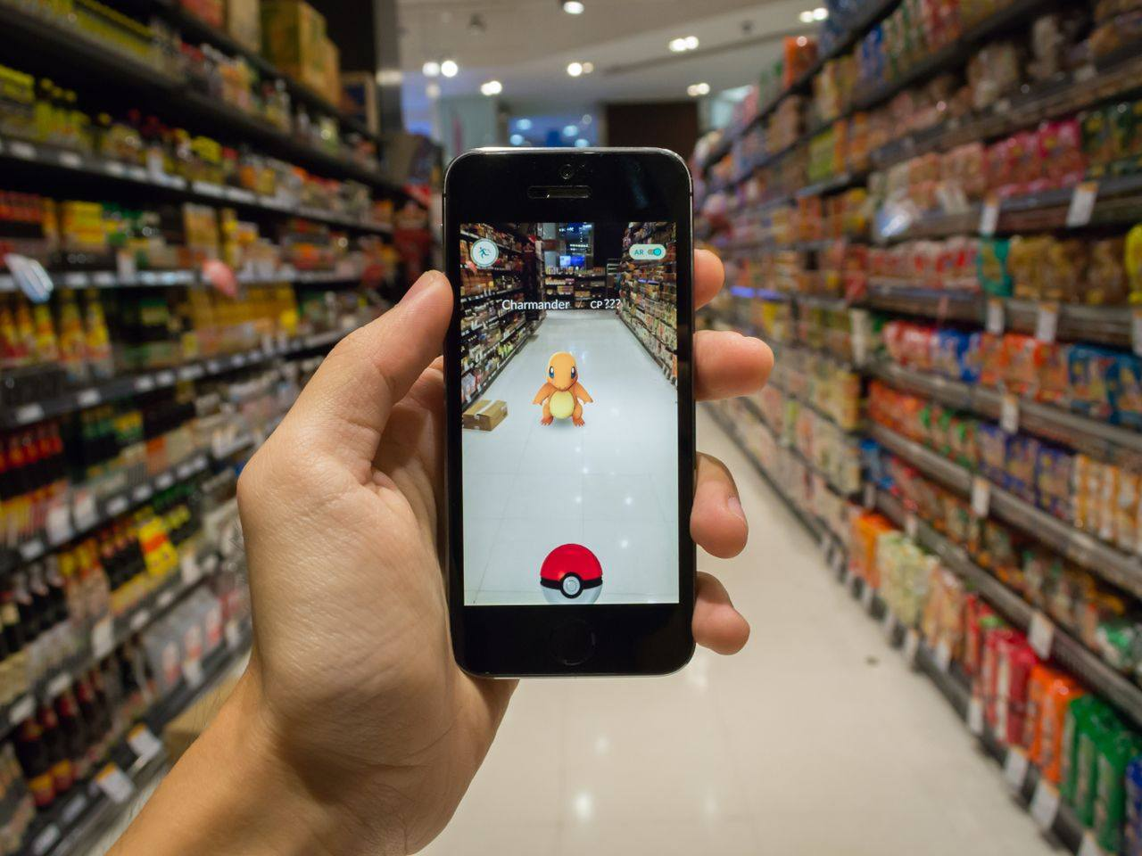
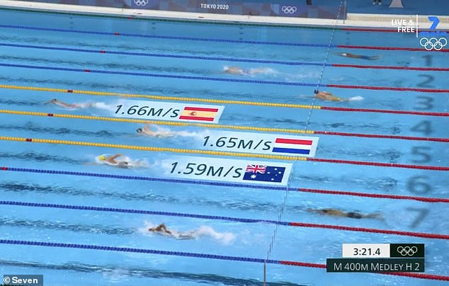
Accessible Technology
AR blurs the lines between the virtual world and reality
Can anyone access AR easily?
How can AR be incorporated into nursing homes?
Increase in availability for AR technologies
Notes:
Box 1: - Augmented Reality and Virtual Reality are the two front-runners of simulation technology.
- Today we’ll be looking specifically at AR.
- VR - fully immerses the user in a fabricated environment
- AR - blurs the lines between reality and the virtual world
- Supplementing reality rather than replacing it.
Explain examples
Box 2/3: AR has gone beyond the world of games and large corporations and is now becoming increasingly available as an interface for everyday use. It’s not designed to replace reality but to add information to it. Anyone can access AR, all you need is a mobile phone or tablet and a Wi-Fi connection. In our fasting evolving world, this technology is incredibly progressive.
Box 4: We can see AR becoming a front-runner in medical and senior care environments as it provides new advances in the areas of social connection and rehabilitation. Video-calling for example is a main feature that can be improved by AR for elderly people. This is especially beneficial now in the age of Covid-19.

Slide 4
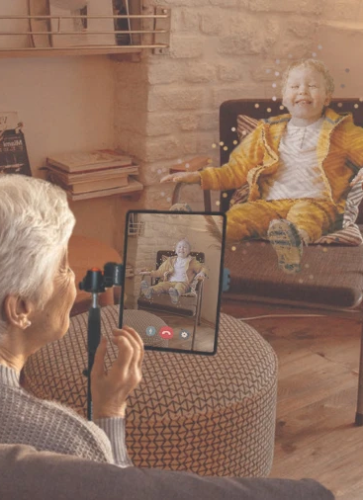
Social Well-being
Seeing family improves social connection
Environmental AR immerses the elderly in the natural world
AR promotes independence
Notes:
Box 1:
Social isolation is a serious problem for elderly adults. With depression increasing by up to 60% their first year in a nursing home.
In a quote from an article on AR and wellbeing for older adults by Lee et. Al., It is said that “Positive technology ultimately aims to improve the overall quality of life by promoting human wellbeing, satisfaction, and contentment.”
Most older adults who dislike technology simply don’t understand it. Prompting the need for a more streamlined interface.
AR can improve quality of life, through virtual interaction such as video calls with remote family members
A study found that virtual social interactions increased non-verbal behaviour such as attentiveness and eye-contact
Box 2:
Mimicking an outdoor environment can be helpful for those elderly who are less mobile, cannot go outdoors frequently.
Accessibility to virtual environments can help to relieve anxiety, isolation and chronic pain
Some AR apps can display realistic nature elements on the screen that move when the device is moved, trees, animals, oceans etc.
Box 3:
AR helps the user to feel more in control by keeping them in the real world.
Playing games can also promote a feeling of independence, giving the the user choice over what they want to do and how they choose to do it.

Slide 5
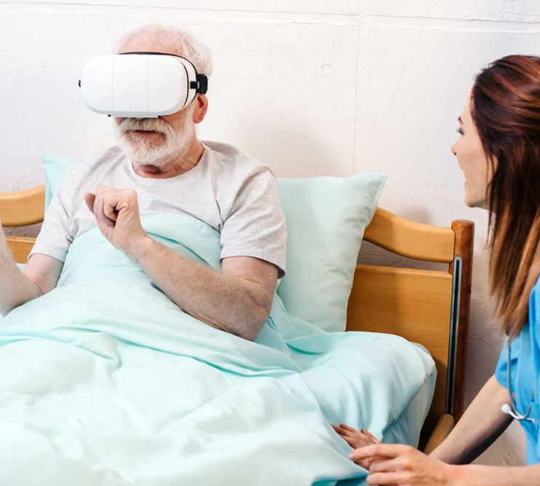




Medical Benefits
Physical Well-being
Mental Well-being
Fine Motor Skills
Rehabilitation
Notes:
Physical wellbeing:
Elderly people often struggle with chronic illnesses and a lack of mobility which makes physical exercise difficult
AR can encourage an interest in physical activity and increase safety for physical therapy.
Can also increase spatial awareness, a study on mental rotation tasks tested an elderly person’s ability to interact with a 3D object on the screen. After 6 weeks their reaction time was significantly improved
Such as placing a screen in front of an exercise bike so the user can see themselves riding through a virtual environment
Mental wellbeing:
AR can be beneficial for people with Alzheimer’s and dementia
In an example from the previously mentioned article, a virtual supermarket was set up allowing dementia patients to complete simple shopping tasks and refine their mental skills
Playing virtual games helped with cognitive preservation, fine motor skills and memory skills.
AR can also develop virtual animal companions
Rehabilitation:
Rehabilitation practices can also use AR with programs and apps that encourage specific hand and foot movements,
Hand-eye coordination and improving reflexes
Stroke survivors can benefit from AR by moving virtual objects and interacting physically with a screen

Slide 6
Drawbacks
Less real social interaction
Unnatural technology
Familial negligence
Physical side effects
Technical difficulties
Notes:
1-2. With the increase in availability for virtual social connection there may be drawbacks in terms of real-life social interaction. The temptation would be to replace a human or family connection with a virtual one simply for ease and convenience. People need physical love and human connection to survive so an absence of this would be very detrimental. A family member may feel tempted to no longer visit their elderly relative simply because technology can do it for them.
3. On top of this, for elderly people, using technology can tend to be confusing and unnatural as this is a generation that didn’t grow up with the technological advances that we have today. Time and human resources need to be invested in in order to even teach an elderly person how to use AR optimized device.
4. AR’s artificial light and display can cause eye-strain, disorientation and discomfort
Visually induced motion sickness and dizziness can occur when looking at a moving image on a static screen
Epileptic people should not use such devices
5. Low latency or lag with an unsteady Wi-Fi connection can cause disorientation and confusion for an elderly person and limit the effectiveness of the device

Slide 7





Conclusion
Benefits
Efficient
Affordable
Benefits
Drawbacks
Benefits
Notes:
With proper care and consideration, the benefits outweigh the drawbacks
AR can be an efficient and affordable source of technology for use within the elderly population. It’s medical and social benefits alone have been proven to be greatly effective.
With this said, it should be used sparingly as in all cases, real-world social interaction is paramount in maintaining healthy relationships and good mental health in the elderly and their families alike.
I am excited to see where AR goes in the future and what it can offer for people of all ages and backgrounds

Slide 8
References
Kipper, G and Rampolla, J, 2012. Augmented reality: an emerging technologies guide to AR. 1st ed. Elsevier Science and Technology Books, pp.1-54.
Miller, M, Jun, H, Herrera, F, Yu Villa, J, Welch, G and Bailenson, J, 2019. Social interaction in augmented reality. [online] Public Library of Science. Available at: <https://go-gale-com.ezproxy.cqu.edu.au/ps/i.do?p=AONE&u=cqu&id=GALE%7CA585418408&v=2.1&it=r> [Accessed 27 April 2022].
Aukstakalnis, S, 2016. Practical augmented reality: a guide to the technologies, applications, and human factors for AR and VR. Crawfordsville, Indiana: Mark L. Taub.
Lee, L, Kim, M and Hwang, W, 2019. ‘Potential of augmented reality and virtual reality technologies to promote wellbeing in older adults’. Augmented reality: current trends, challenges and prospects, [online] Available at: <https://www.mdpi.com/2076-3417/9/17/3556/htm> [Accessed 27 April 2022].
Hsiao, K and Rashvand, H, 2013. Data modeling mobile augmented reality: integrated mind and body rehabilitation. [online] Available at: <https://link-springer-com.ezproxy.cqu.edu.au/article/10.1007/s11042-013-1649-8> [Accessed 27 April 2022].
Klopfer, E and Squire, K, 2007. Environmental detectives—the development of an augmented reality platform for environmental simulations. [online] Available at: <https://link-springer-com.ezproxy.cqu.edu.au/article/10.1007/s11423-007-9037-6> [Accessed 27 April 2022].
Hoe, Z, Lee, I, Chen, C and Chang, K, 2017. Using an augmented reality-based training system to promote spatial visualization ability for the elderly. [online] Available at: <https://link-springer-com.ezproxy.cqu.edu.au/article/10.1007/s10209-017-0597-x> [Accessed 28 April 2022]
Security, P, 2022. Threats and risks of Pokémon Go, the most played game ever. [online] Panda Security Mediacenter. Available at: <https://www.pandasecurity.com/en/mediacenter/panda-security/pokemon-go-risks-threats-famous-game-moment/> [Accessed 29 April 2022].
Augmented Reality (AR) &amp; Virtual Reality (VR) in Healthcare Market Report 2020, R., 2022. Augmented Reality (AR) & Virtual Reality (VR) in Healthcare Market Report 2020, Industry Overview, Size, Share, Global Trends Analysis, Emerging Technology Advancement, Top Companies, Strategy Profiling, Regional Revenue | Medgadget. [online] Medgadget.com. Available at: <https://www.medgadget.com/2020/01/augmented-reality-ar-virtual-reality-vr-in-healthcare-market-report-2020-industry-overview-size-share-global-trends-analysis-emerging-technology-advancement-top-companies-strategy-pro.html> [Accessed 29 April 2022].
Computerlanguage.com. 2022. augmented reality - CLC Definition. [online] Available at: <https://www.computerlanguage.com/results.php?definition=augmented+reality> [Accessed 29 April 2022].
Biggs, J., 2022. 5 Real Uses for Augmented Reality in Construction Today. [online] Procore.com. Available at: <https://www.procore.com/jobsite/5-real-uses-for-augmented-reality-in-construction-today/> [Accessed 29 April 2022].

